Slide 1
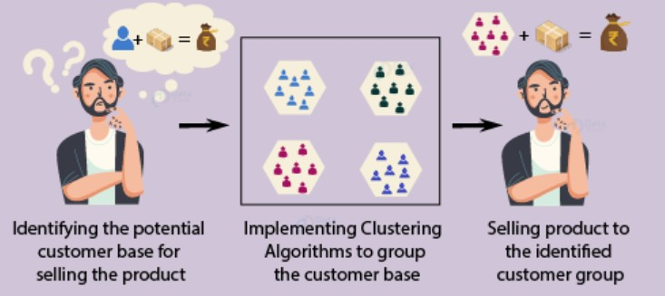
Customer Segmentation Using K-Means Clustering

Slide 2
ABOUT PROJECT
In Today’s World Where there is immense competition in the market customer segmentation plays an important role to earn profit in this cluttered market.
Clustering will help companies to make Groups according to people specific needs and provide them a more advanced way to sell their products.
By using clustering companies will gain maximum profit as they can make products keeping in consideration about the needs of a particular group not an individual.
This will help in uplifting their market Growth.

Slide 3
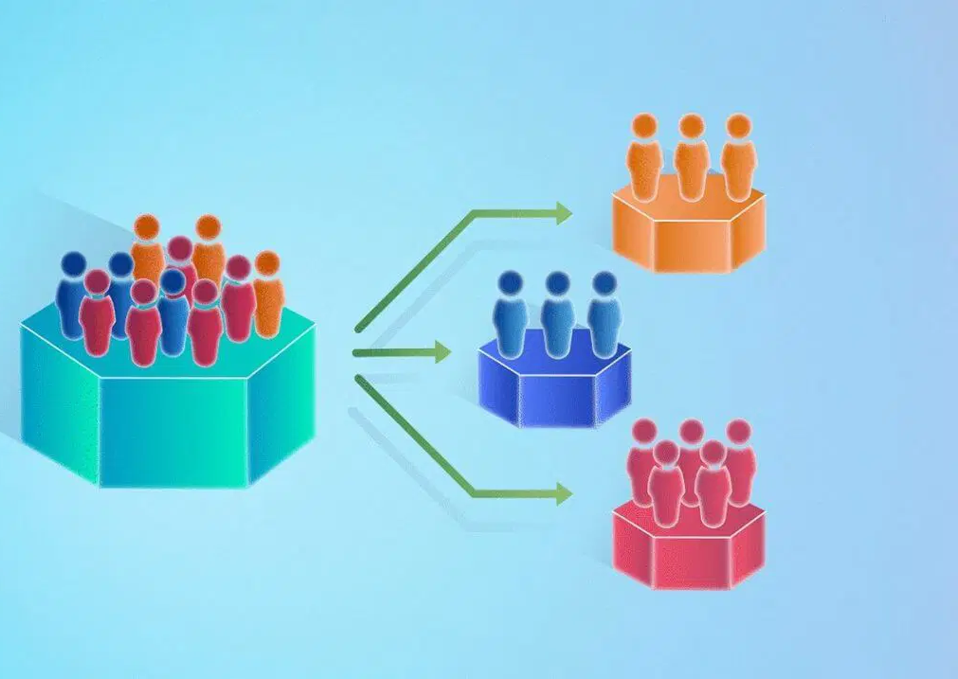
EXAMPLE:
There is a data of lakhs of people in which people of three categories are present
First Category- Rich
Second Category- Middle Class
Third Category- Lower Middle Class
So companies will make segments of these three categories by employing different clustering algorithms.
This will help them to make products according to particular Segments
In this Project we have applied clustering using the K-Means method

Slide 4
K-Means Clustering
K-means works with unlabeled data, meaning the data points don't have predefined categories. It groups them based on similarities identified during the clustering process.
You need to specify the number of clusters (k) beforehand. This value significantly impacts the resulting groupings.
The algorithm aims to minimize the total distance between data points and their assigned cluster's centroid (center). This ensures points within a cluster are similar to each other.
K-means works iteratively. It starts with initial centroids, assigns points based on closeness, recalculates centroids based on assigned points, and repeats until convergence (centroids stabilize) or a maximum iteration is reached.

Slide 5
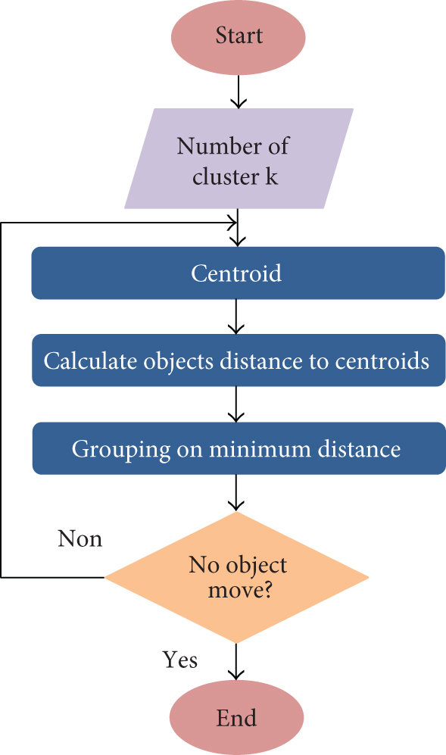
STEPS:

Slide 6
ELBOW MEATHOD
Helps determine the optimal number of clusters (k) for K-means clustering.
It's a graphical approach that plots the Within-Cluster Sum of Squares (WCSS) on the y-axis and the number of clusters (k) on the x-axis.
WCSS represents the total squared distance between data points and their assigned cluster centroid. Lower WCSS indicates tighter clusters with less within-cluster variation.

Slide 7
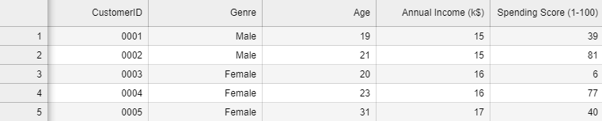
DATASET DESCRIPTION
Contains 5 columns:
Customer-Id
Gender
Age
Annual Income(k$)
Spending Score(1-100)
200 rows are taken each containing information about 1 person

Slide 8
MEATHODOLOGY
1.Data Collection and Processing:
The given data set is read into a data frame (df). We will display few first row of the data set using df.head(), to get an initial overview of the data.
2.Splitting the features and Target:
Features, including "Annual Income (k$)" and "Spending Score (1-100)", are selected from the dataset and stored in a separate Data Frame X.
3.Splitting the data into Training and Test Data:
There is no explicit splitting of data into training and test sets. However, it's a common step in machine learning workflows to split the data for model training and evaluation.
4.Model Training:
The K-Means algorithm is leveraged for clustering the data. Using elbow method, we can find the optimal number of clusters and for training the model, KMeans class is used from SckitLearn Library.

Slide 9
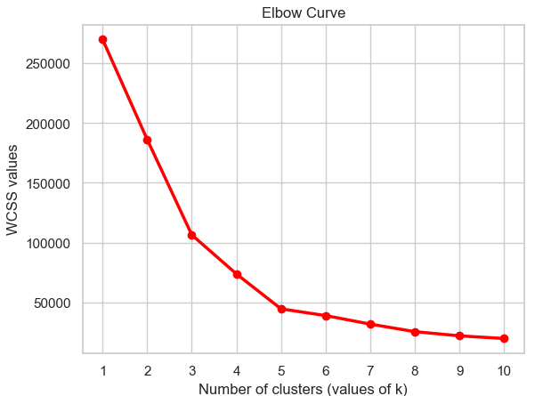

5.Model Evaluation:
We will determine the optimal number of cluster using the method named as Elbow method, which analyze the Within Cluster Sum of Square (WCSS) to find the critical point where supplementary clusters no longer considerably diminished the WCSS.
WCSS$=\sum_{C_{k}}^{C_{n}}{(}\sum_{d_{i in Ci }}^{d_{m}}{d{istance(d_{i} , C_{k})}^{2})}$
Where C is the cluster Centroid and d is the data point in each Cluster.

Slide 10
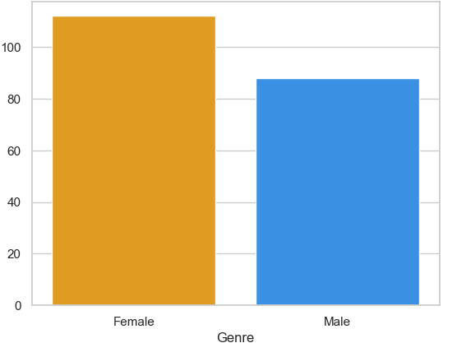
Class Distribution of Sentiment
It shows the overall distribution of dataset
That will show how many male and female
Members are there.

Slide 11
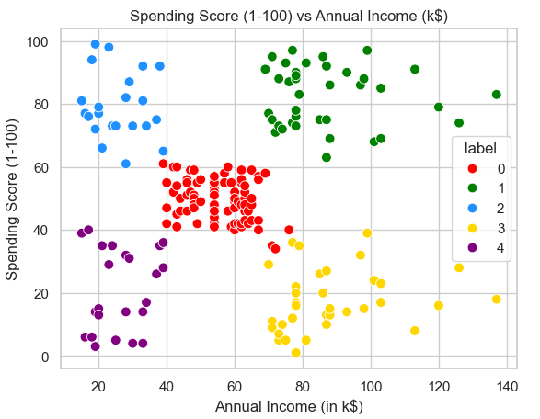
Scatterplot of Clusters
Cluster 0: the cluster 0 which is red coloured and is in the center signifies medium annual income and medium yearly spending score.
Cluster 1: the cluster 1 which is green coloured and is in the above right corner signifies high annual income and high spending score.
Cluster 2: the cluster 2 which is blue coloured and is in the above left corner signifies low annual income and high yearly spending score.
Cluster 3: the cluster 3 which is Yellow coloured and is in the lower right corner signifies high annual income but low yearly spending score.
Cluster 4: the cluster 4 which is voilet coloured and is in the lower left corner signifies low annual income and low yearly spending score.

Slide 12
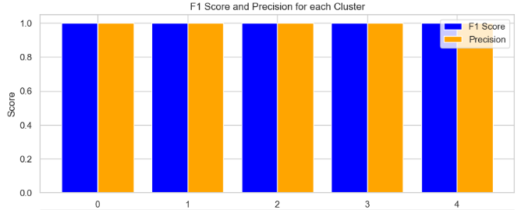
Result
As K-Means is an unsupervised algorithm Finding the accuracy of an unsupervised learning algorithm can be challenging as there are no true labels to compare the result against. In unsupervised learning F1 and Precision score always be 1 because we are using the Unsupervised approch. If we want more precise and accurate result we want to use the Silhouette score method of K-Means.
To verify and evaluating the performance of the clustering algorithm we calculated F1 score and precision. F1 score determine the accuracy of the model while precision measure the proportion of the true positive prediction to the total number of genuine predictions. Representation like bar plots and tables are created to display the F1 score and precision value for each cluster.

Slide 13
Thank You

